Slide 1
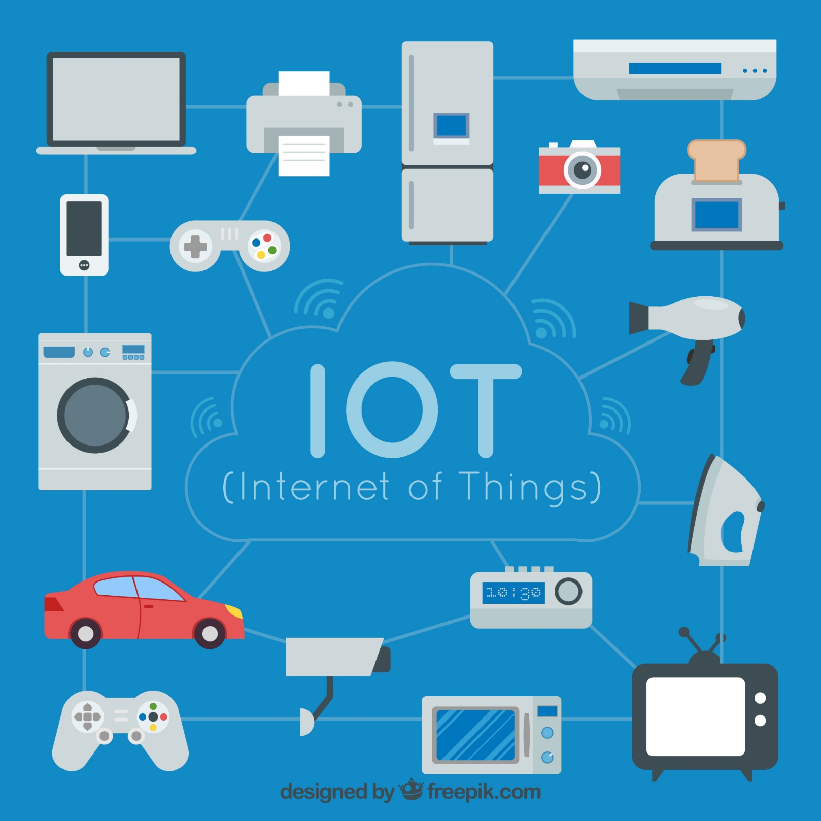
Introduction to Internet of Things

Slide 2
Internet
of
Things

Slide 3

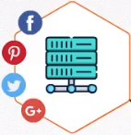
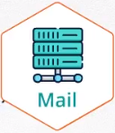
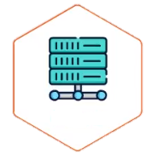

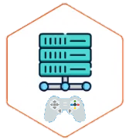






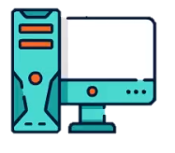
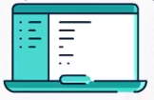





What is IoT?
Server
IOT Apps

Slide 4





IoT application
Main Categories
1
3
5
2
4
Home Consumers
Health/ Body
Buildings/
Infrastructure
Cities / Industry
Transport /Mobility
Characteristics
Characteristics
Characteristics
1
Challenge
Characteristics
Characteristics
1
Serving many devices
1
Long life battery devices
Devices needs long life battery
1
Less Number of Apps
1
Challenge “location based “
2
Free of charge
2
Serving few devices
2
High revenues

Slide 5



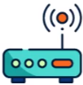









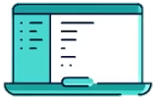


IoT value chain
VS
Mobile app value chain
Mobile app value chain
Device
/App
Wi-Fi
Wi-Fi Router
Carrier
Network
Server
✓Sent
✓received
Device and Gateway remote management
End-End system Integrators
IoT value chain
Application Enablement Platform
Big Data Analytics Platforms
Device
Sensor
Wireless Sensor Networks
IoT Gateways
Carrier
Network

Slide 6
What will we Learn through this Lab?!!
Please, refer to this document to complete this Lab

